Slide 1
Card design and recommendations

Slide 2

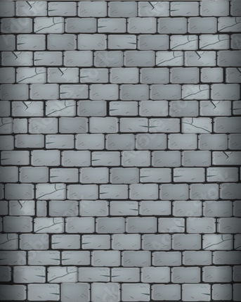

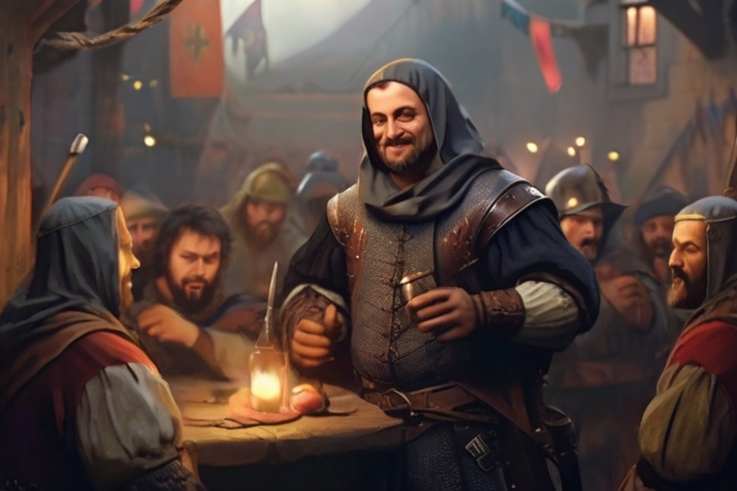
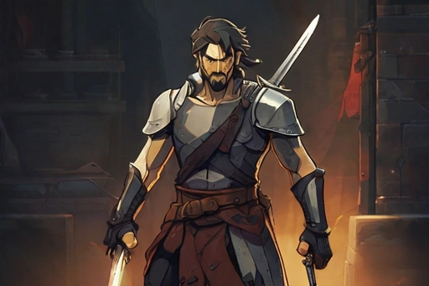




General design:
4
3
Taveren
A good war needs good
boose in the breaks
Swordmaster
A blade in my hands is
Never dull
Bosts attack, health and
attack speed with 10%
Reduces movement speed with 20%
This unite moves slow
20
100
Tower
Unite

Slide 3
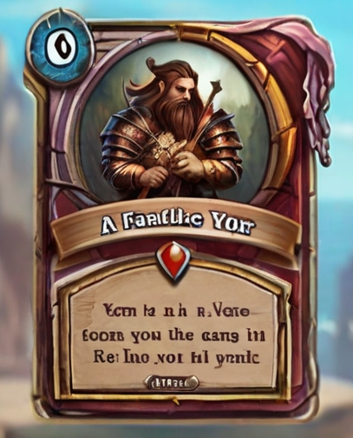
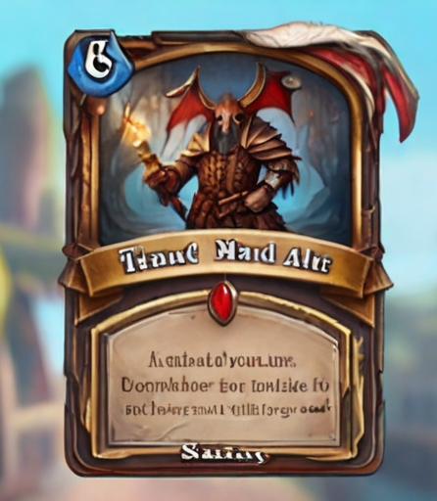
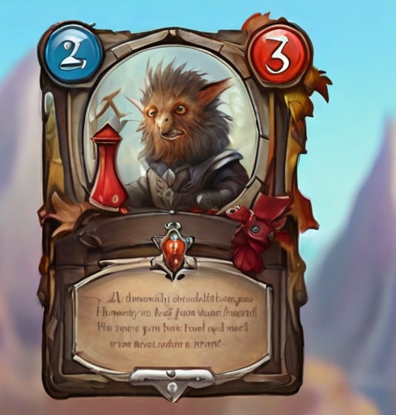
AI generate bilder

Slide 4
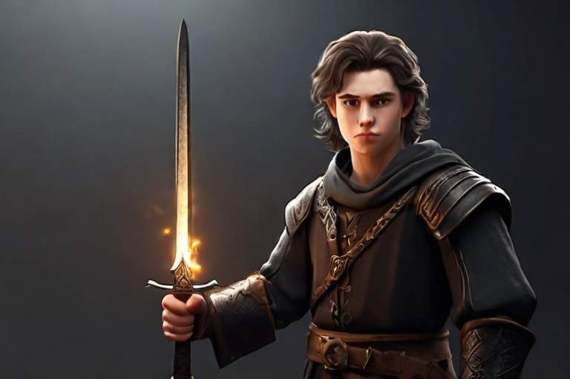
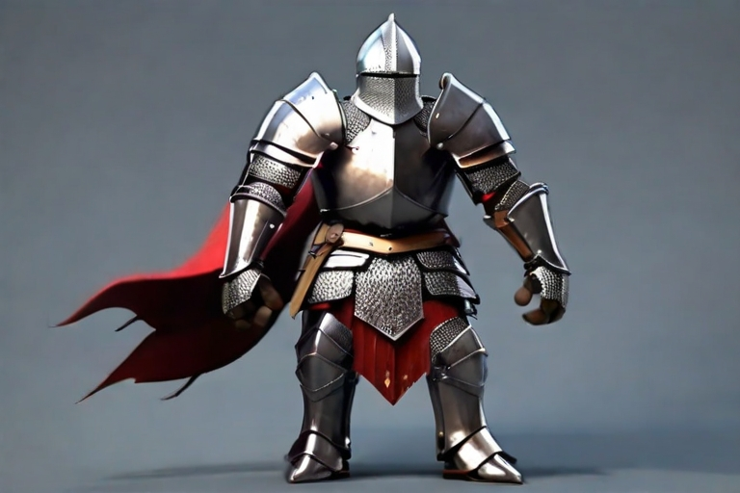
2
3
Atheist
My faith is stronger
than yours
Peacefull warrior
I AM here to protect
Immune against spells
Allies can not go past this unite
10
100
0
300
Unite
Unite

Slide 5
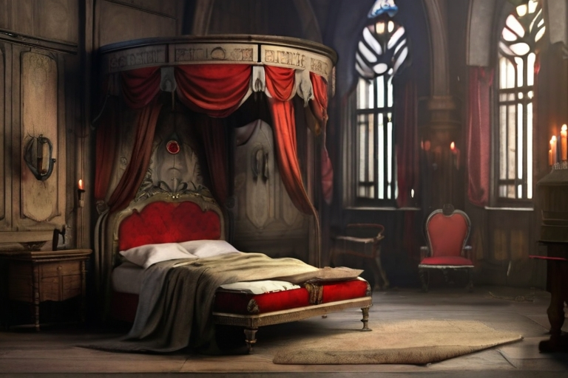

5
3
Brothel
A good night for golden coin
Damsel in destress
Love a first sight can
Makes the first enemy unite pay a golden coin and immobilize them for 10sek
Can only be destroyed when there is a customer.
Is immobilized and immobilizes the first enemy unite she encounters.
0
100
Tower
Unite

